Slide 1
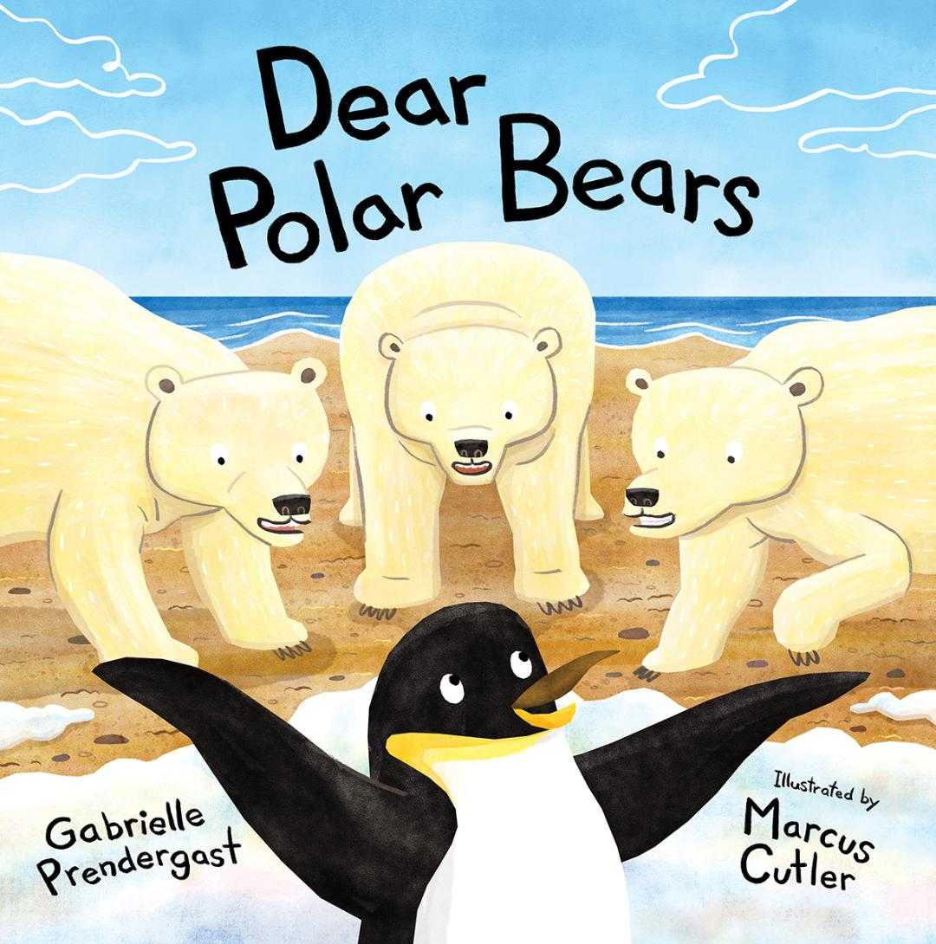
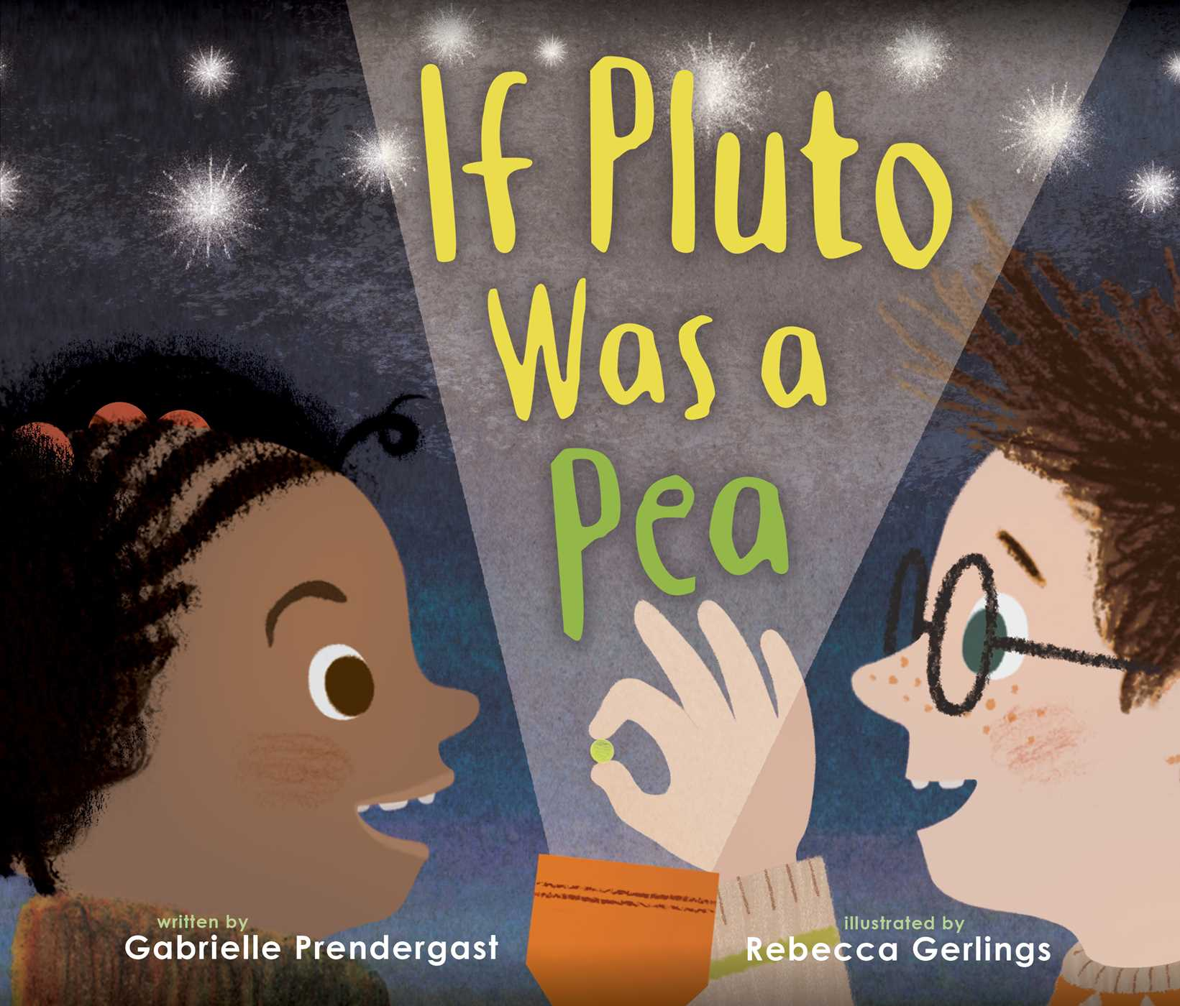
Elevating Your Work: How to Create Children’s Picture Books That Are Not Just Entertaining, but Transformative
With author
Gabrielle Prendergast

Slide 2
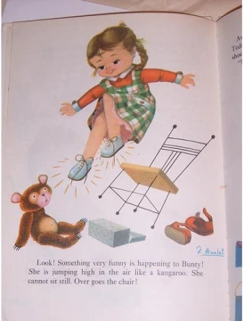
Picture Book vs. Story Book
Picture books are typically under 500 words
Storybooks can be longer (up to 2500 words or more)
Picture books usually rely at least partially on the illustrations to tell the story
Storybooks are often more akin to short stories with ancillary illustrations
Picture books are suitable for reading aloud
Storybooks are more geared towards independent reading
Picture books (apart from those made as “branded” books like Disney or Barbie) are more often divergent interpretations of classic or traditional stories (fairy tales for example) – Bunty and the Magic Shoes
Storybooks are often direct retellings or transcriptions of classic or traditional stories – The Red Shoes by Hans Christian Andersen
Storybooks are very hard to sell. Most of them are produced “in-house”
Storybooks are sometimes published as “early readers” – For example The Berenstain Bears

Slide 3
What Is a Picture Book?
Is it a story told with words and/or pictures?
There are wordless picture books
There are a few picture-less picture books
A picture book is a book, typically for children, in which the illustrations (or the LOOK of the words) are as important as—or more important than—the words in telling the story.

Slide 4
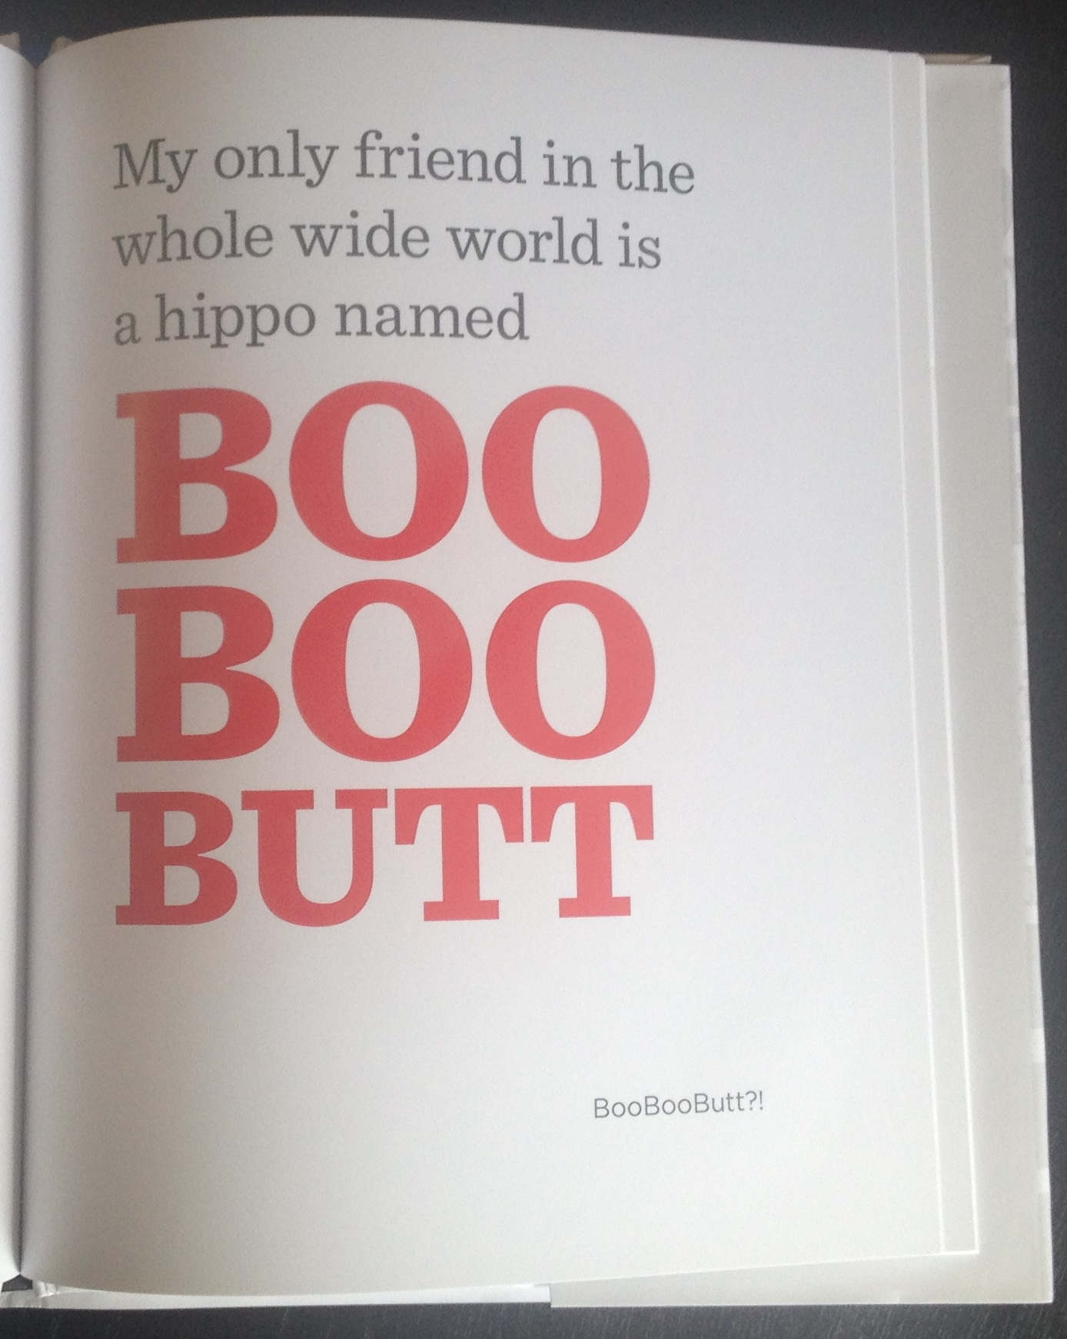
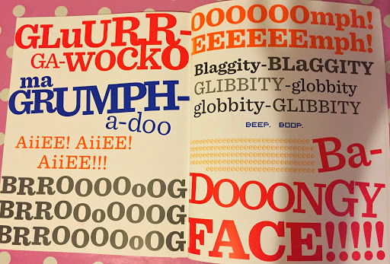
The Book With No Pictures by BJ Novak
Usually there is some interplay between words and images

Slide 5
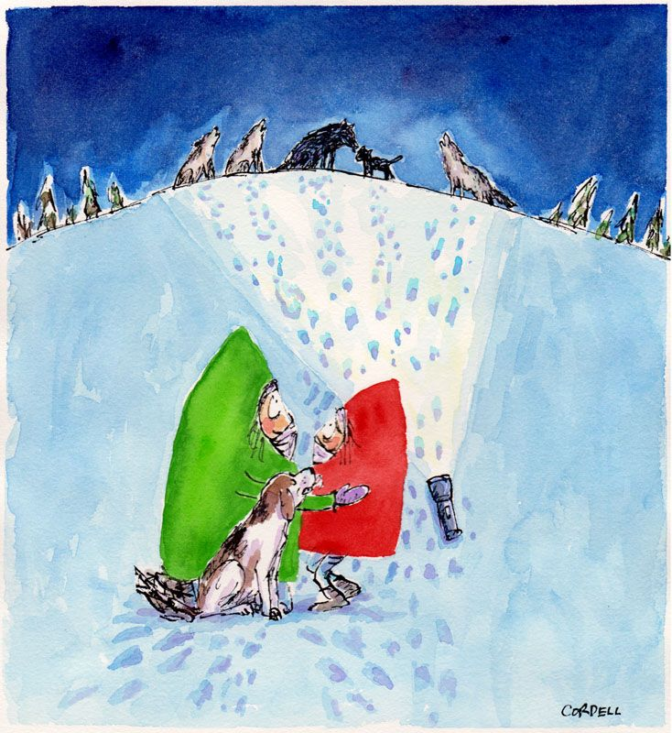
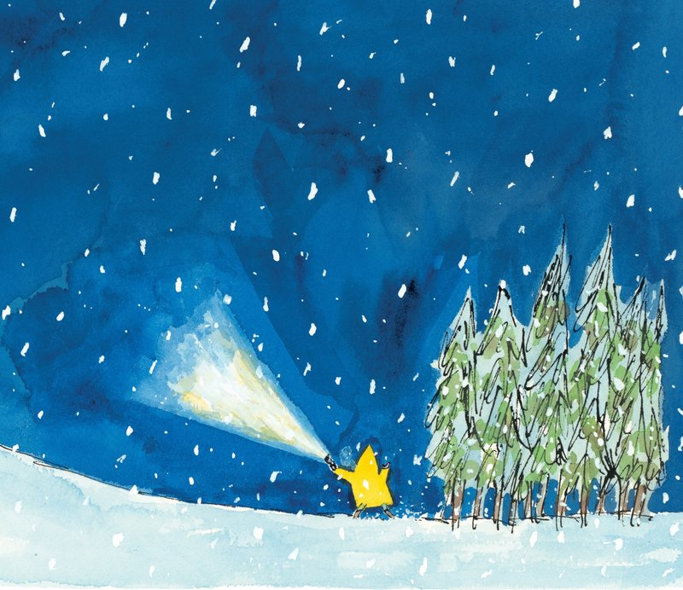
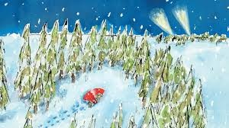
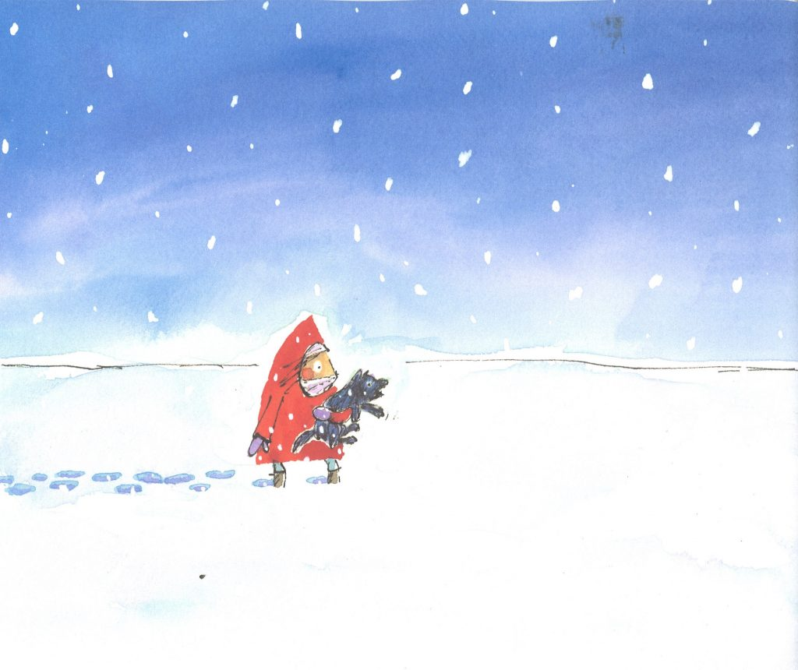
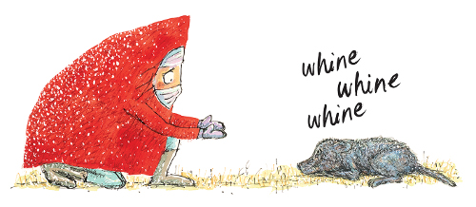
Wolf in the Snow (Wordless Picture Book)
By Matthew Cordell

Slide 6
Why Write Picture Books
Strong market always looking for new ideas
Many picture books have very long lives as new readers are born
High demand from schools and libraries
They’re fun
You can write about almost any topic
✗ They’re easy

Slide 7
How to start: what you need to know
Don’t try to illustrate your own unless you are a professional artist
You don’t need to find artists unless you are self-publishing
Picture books are typically 24-40 pages
It’s very hard to get an agent with a picture book unless you are also an artist
You can submit picture books directly to some publishers

Slide 8
How to Start: Inspiration
Questions children ask “How small is Pluto compared to Earth?”
Things children say – take notes!
Non-fiction topics such as biographies
Family stories
Word play – ie. The Wonky Donkey by Craig Smith
Retellings or Subverted tropes – ie. The Paperbag Princess by Robert Munsch
Idioms or turns of phrase – Sheep in Wolves' Clothing by Satoshi Kitamura

Slide 9
Homework 1
Exercise: Collect a list of unusual or interesting sounding words. What does the SOUND of these words inspire? What about the MEANING?
Examples:
Curmudgeon — (n) a bad-tempered person
Cacophony — (n) a harsh, discordant mixture of sounds
Flummox — (v) to perplex someone greatly
Gibberish — (n) unintelligible or meaningless speech
Kerfuffle — (n) a commotion or fuss
Ragamuffin — (n) a person, typically a child, in ragged dirty clothes
Whippersnapper — (n) a young person considered to be presumptuous or overconfident
Woebegone — (adj) sad or miserable in appearance
Develop some of the words into picture book ideas or texts
Ex. The Curly Curmudgeon - (a bad tempered poodle?)
Cacophony Cove – A very noisy town? Maybe the sea lions are always barking!

Slide 10
How to Start: Who is your reader?
who is the reader?
  any age from 0-100+
always think about boys AND girls reading
always think about culture/race/background (ie not all kids celebrate Christmas etc)
-picture books are usually aimed at children but often read by adults TO children
  call and response
  incorporating a song
early language learning (“Goodnight…?” “Moon!”)
some picture books are aimed at older children to read to themselves
  tend to be either narrative (not word play or call and response) or informational
-some are geared towards classroom use
  often themed (bullying, science themes, cultural or historical themes)
-what will children understand? What will they not understand?
  Vocabulary
  Themes
  Subject matter

Slide 11
How to Start: Thinking about Illustrations
how will the illustrations fit with the story?
usually 24-32 pages or 12-14 “spreads” (must be a multiple of four)
You can include critical illustration notes in your text if necessary
Often part of the story is told through the illustrations “Let the wild rumpus start” (Where the Wild Things Are by Maurice Sendak):

Slide 12
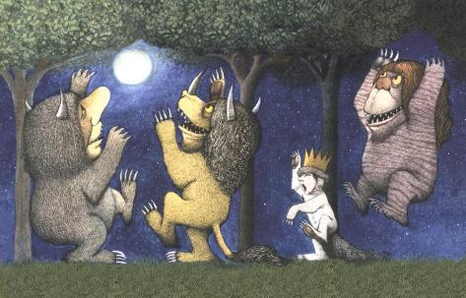
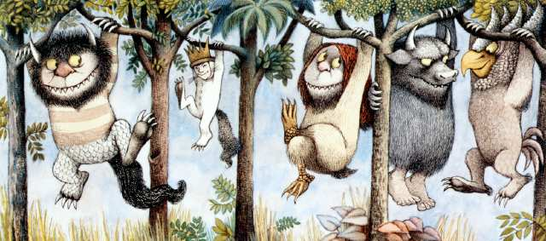
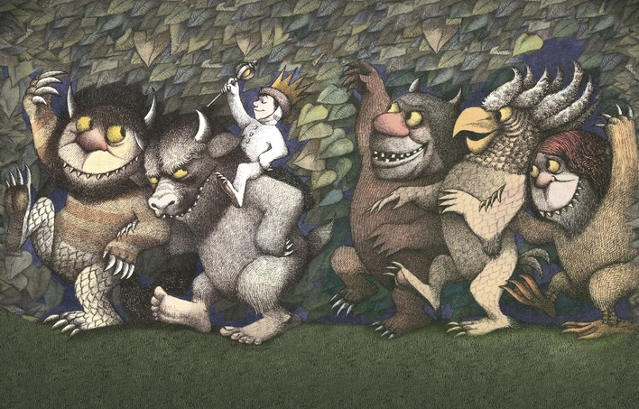

Slide 13
How to Start: Thinking about Illustrations
Give the story “room” for illustrations
you won’t choose the illustrator
you won’t decide HOW the story is illustrated (ex If Pluto Was a Pea)
The illustrations might change or define the narrative of the story

Slide 14
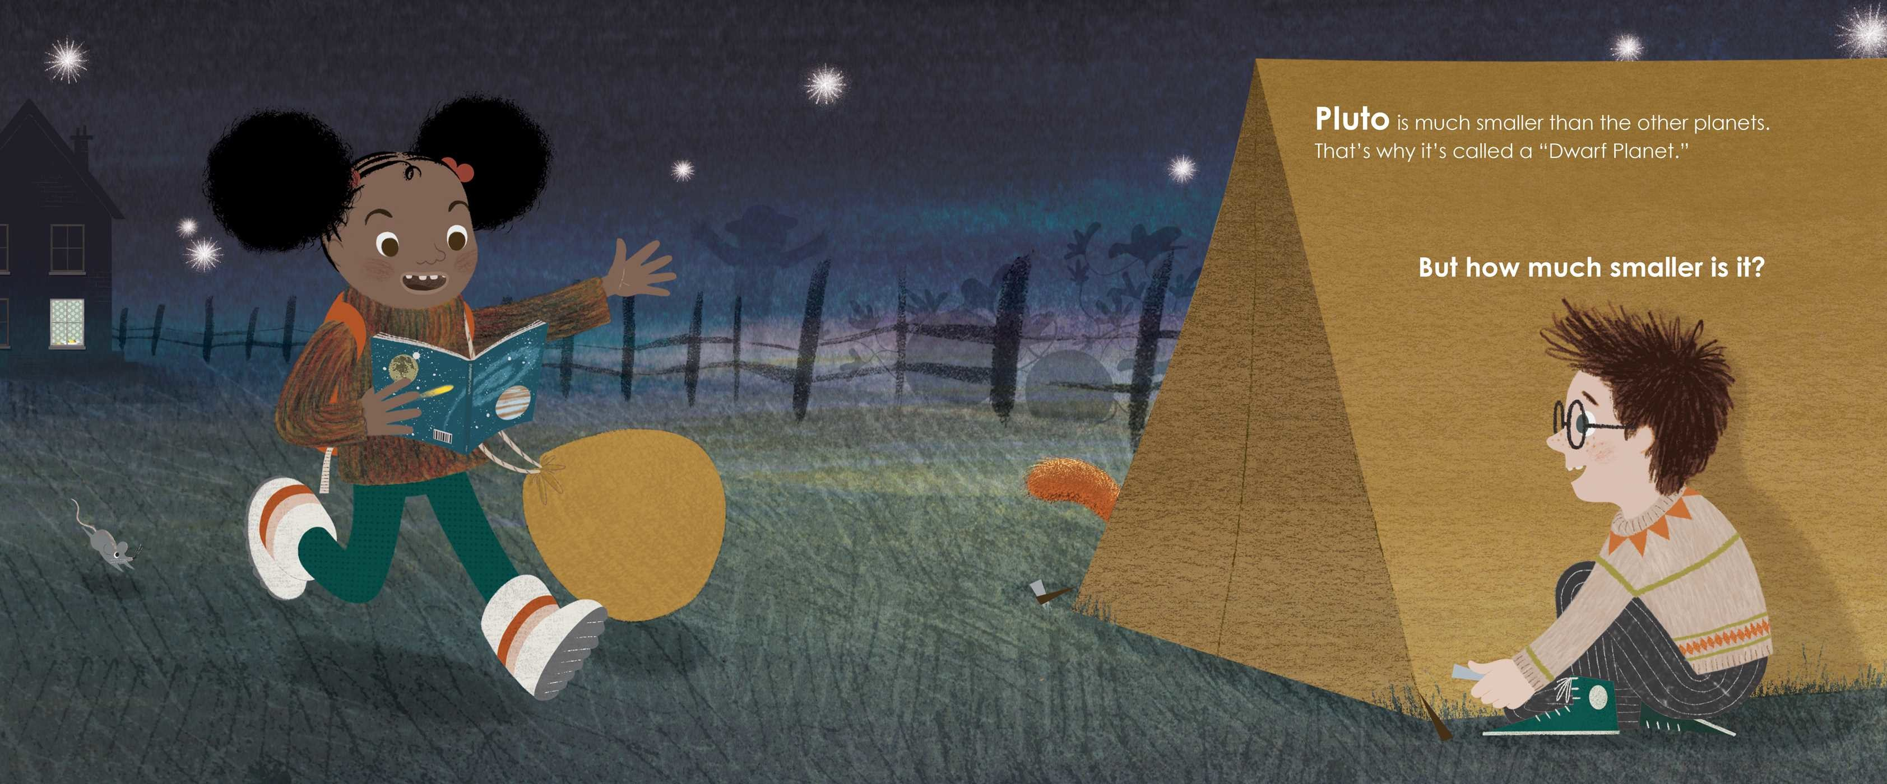
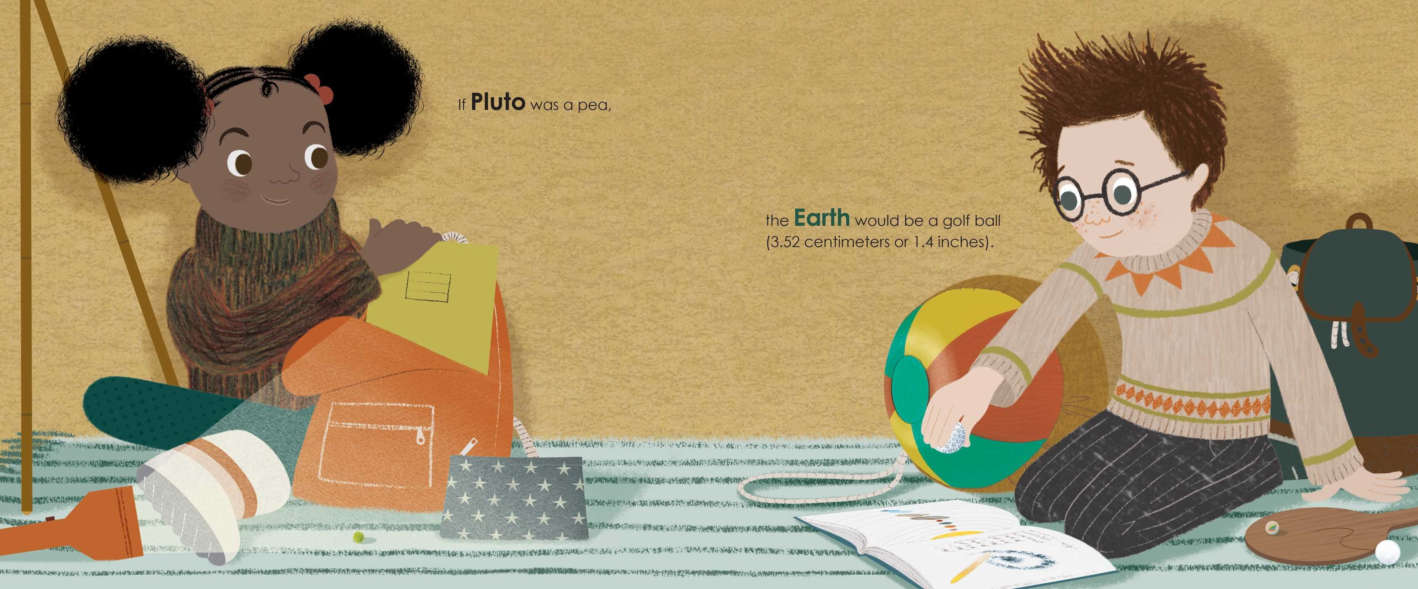

Slide 15
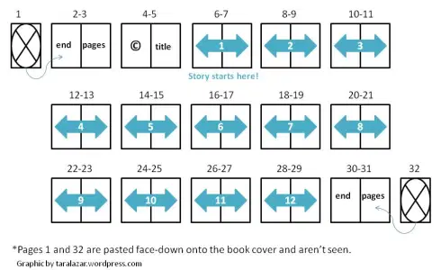
How to Start: Thinking about Illustrations
You can use a “dummy” to pace out your story and see how the illustrations will fit

Slide 16
Homework 2
Make a picture book “dummy” either by stapling pages together (ending up with 28 pages or 14 “spreads”) or in Word, Publisher or other app. Enter your own words or the words of a poem, prayer, song lyrics etc. Include sketches/notes about what the illustrations could be.

Slide 17
Writing Your Picture Book: Things to Keep in Mind
Brevity
How does it sound?
Point of View and Tense
Form/format
Tone/Style
Who is your protagonist?

Slide 18
Brevity
Discussion Question: Why Are Very Short Picture Books Popular?
Under 500 words is ideal
Say Goodnight by Helen Oxenbury (20 words!)
    Up, Down, up in the sky
    Swing Low, swing high
    Bumpity Bumpity hold on tight
    Hush little babies say goodnight
I Want To Be An Astronaut by Byron Barton - 86 words
Goodnight Moon by Margaret Wise Brown – 131 words
Where The Wild Things Are 338 words
If Pluto Was Pea 325 words

Slide 19
In Class Exercise 1
write a children’s Haiku (17 syllable poem with lines 5/7/5 syllables)
Example:
The white duck says “quack!”
The water runs off her back
“Quack!” says the duck. “Quack!”

Slide 20
How Does It Sound?
What are some of things your English teachers taught you to look for in the WORDS or sound of poetry? (ie not metaphor or imagery etc)
Rhythm/meter
    I want to be an astronaut/ A member of the crew
    da dah da dah da dah da da(iambic tetrameter)/da dah da dah da dah
    And fly on the space shuttle/Into outer space
    Da dah dah da dah da da/ dah da dah da dah
Rhyme - rhyming picture books are HARD and very few agents/editors will even look at them BUT that doesn’t mean you can’t incorporate rhyme into your story
    “But the wild things cried, “Oh please don’t go—
    we’ll eat you up—we love you so!”
    And Max said, “No!”
    (actually typeset as above with line breaks)
Or Rhyming wordplay – ie. The Wonky Donkey by Craig Smith

Slide 21
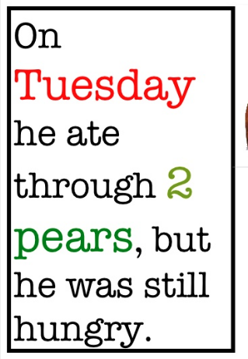
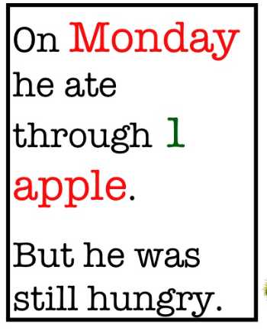
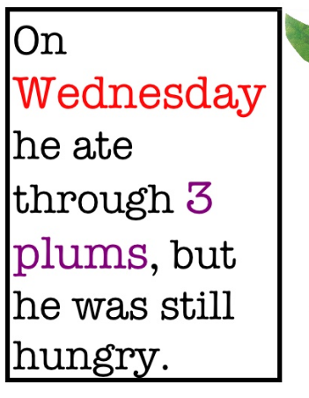
How Does It Sound?
Repetition
From The Very Hungry Caterpillar by Eric Carle

Slide 22
In Class Exercise 2 (handout)
Using The Very Hungry Caterpillar as a model we are going to write our own picture books
Choose an animal (you can name them if you want) - caterpillar
Choose an emotion or state - hungry
Choose an action relating to that state “ate through one…”
Have your animal go through the days of the week like the very hungry caterpillar
Try to resolve your story

Slide 23
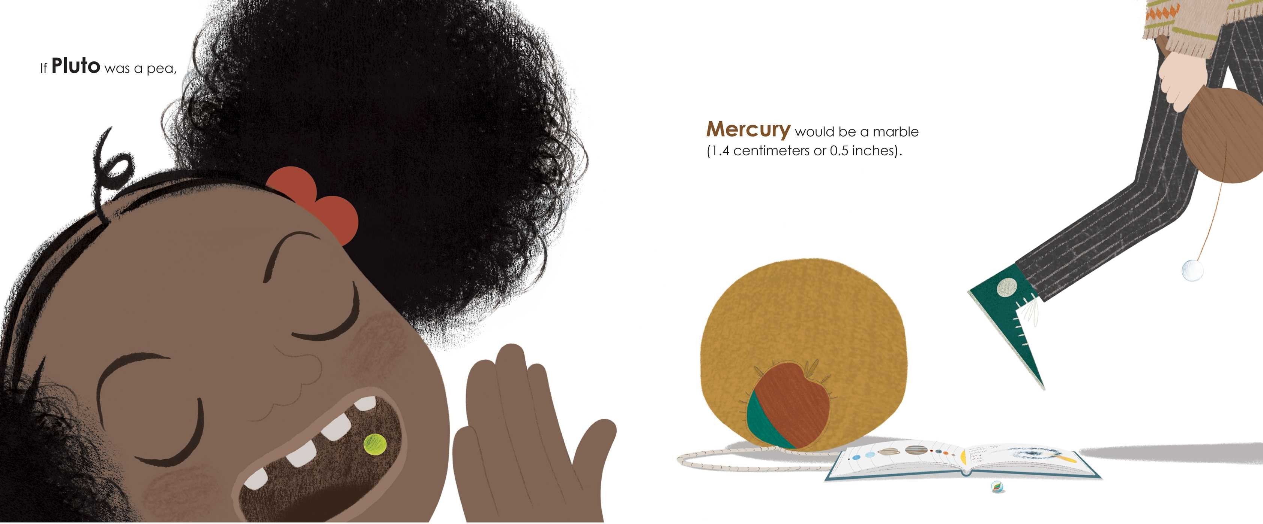
How Does It Sound?
Repetition
From If Pluto Was a Pea by Gabrielle Prendergast

Slide 24
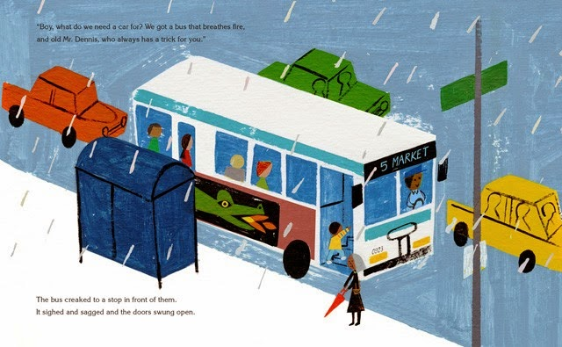
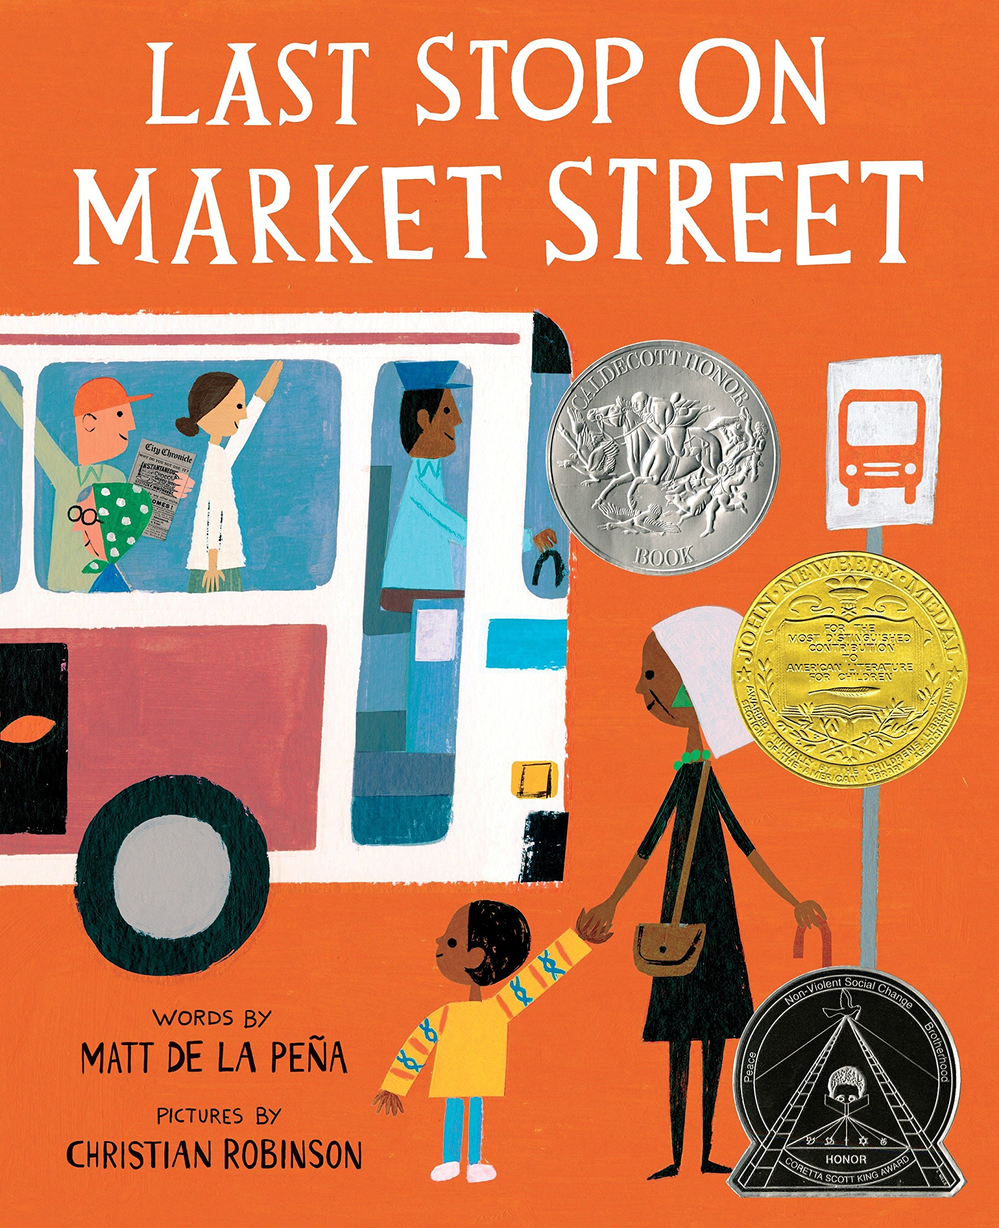
How Does It Sound?
Alliteration
  Popular with alphabet books
    K is for Kissing A Cool Kangaroo by Giles Andreae
    Ellsworth’s Extraordinary Electric Ears by Valorie Fisher
  Also used in prose stories, particularly literary/lyrical picture books
“The bus creaked to a stop in front of them. It sighed and sagged and the doors swung open”.

Slide 25
In Class Exercise 3
Exercise – choosing one or more of the below elements, create short poem for children based on the word “snug”, “moon” or “singalong” (or a word of your choosing)
  Rhythm
  Rhyme
  Repetition
  Alliteration

Slide 26
Point of View/Tense
Who is your narrator?
2nd person quite common
  The Day You Begin by Jacqueline Woodson
Past tense 3rd person
  Where the Wild Things Are by Maurice Sendak
Present tense 1st person
  A Screaming Kind of Day by Rachna Gilmore

Slide 27
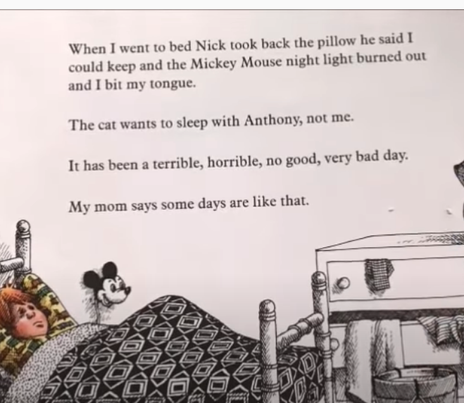
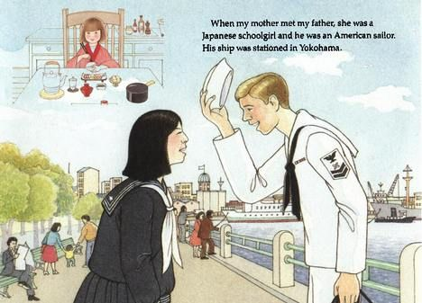
Point of View/Tense
Discussion Question – what effect might using 1st person past tense have on a picture book?
Alexander and the Terrible, Horrible, No Good, Very Bad Day by Judith Viorst (past tense to present perfect to present tense)
How My Parents Learned to Eat by by Ina R. Friedman
Notes:
(answer – a 1st person narrator should be a child. Past tense suggests that they have grown up)

Slide 28
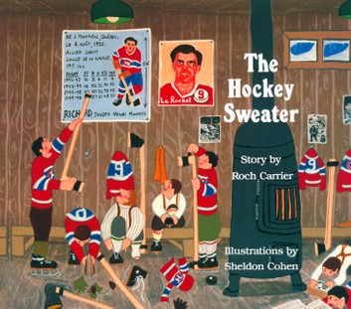
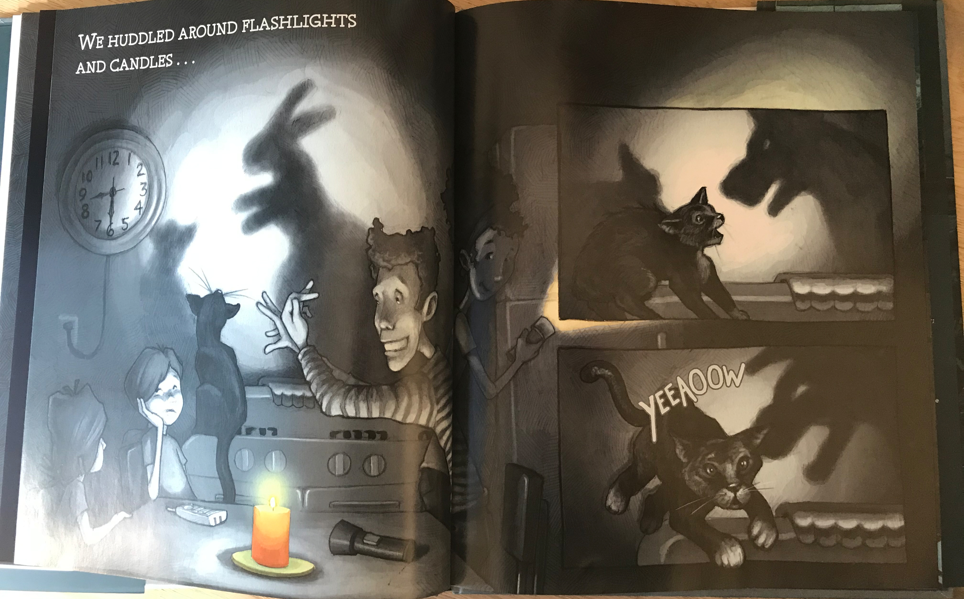
Point of View/Tense
Discussion Question – what effect might using 1st person past tense have on a picture book?
“The winters of my childhood were long, long seasons. We lived in three places - the school, the church, and the skating-rink, but our real life was on the skating-rink.”
Blackout
By John Rocco (2011)
The Hockey Sweater by Roch Carrier
Notes:
(answer – a 1st person narrator should be a child. Past tense suggests that they have grown up)

Slide 29
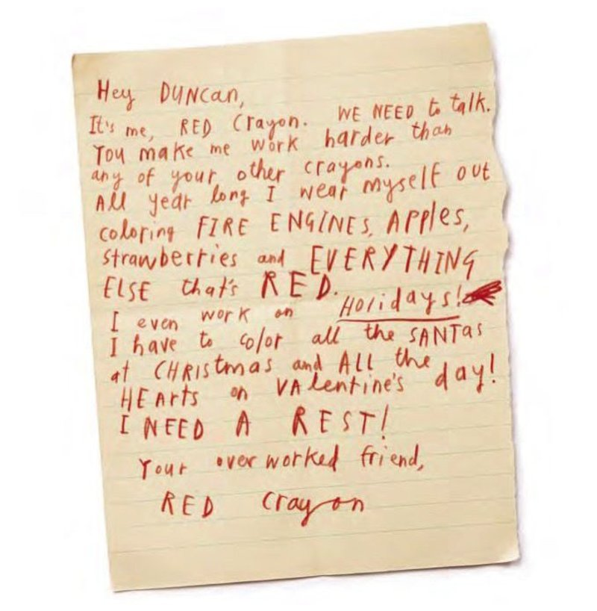
Form/format
Epistolary (letters) – The Day the Crayons Quit by Drew Daywalt
Dear Polar Bears – by Gabrielle Prendergast

Slide 30
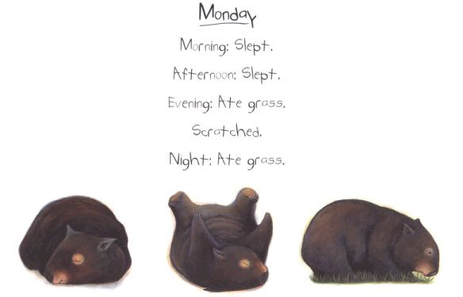
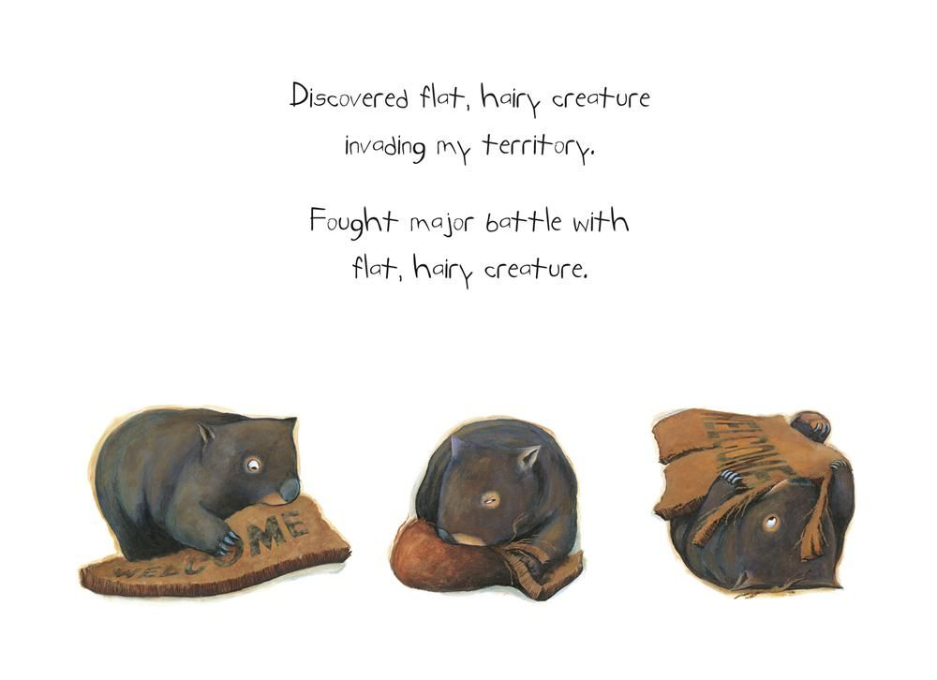
Form/format
Epistolary (diary) – Diary of a Wombat by Jackie French

Slide 31
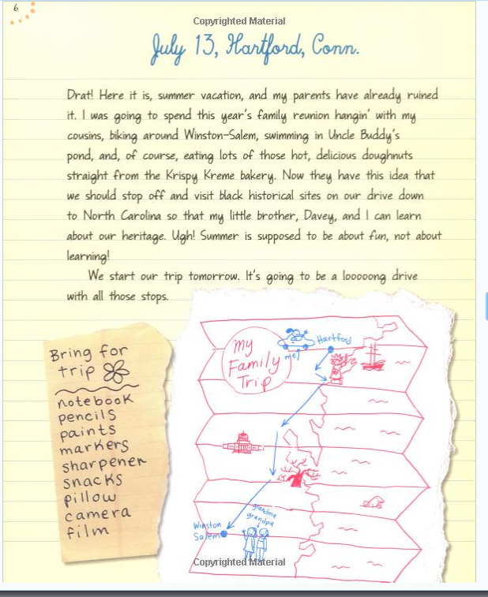
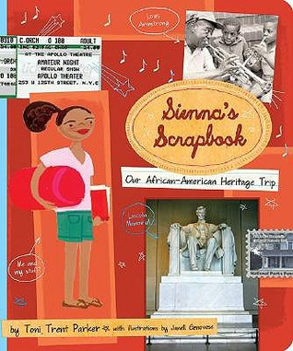
Form/format
Epistolary (varied)– Sienna’s Scrapbook by Toni Trent Parker

Slide 32
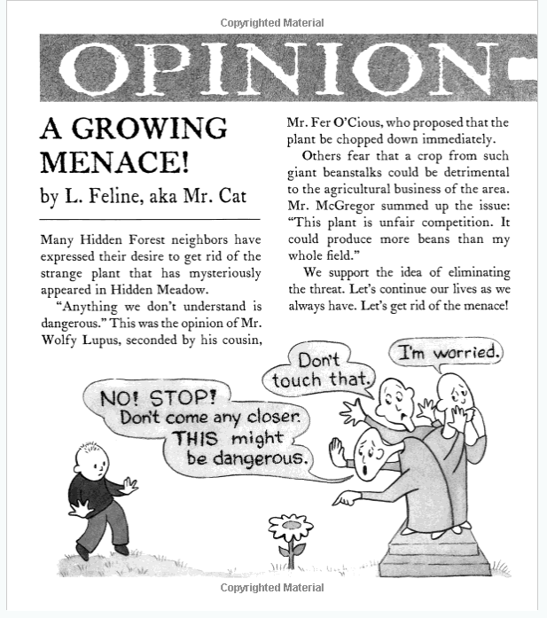
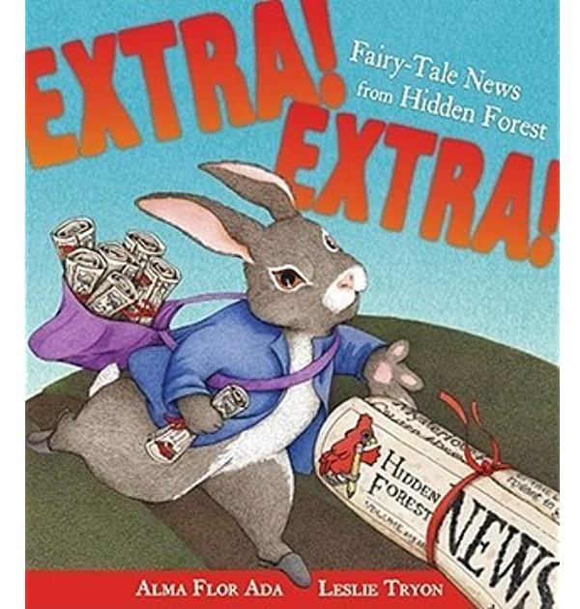
Form/format
Epistolary (newspaper) Extra! Extra! Fairy-tale News From Hidden Forest by Alma Flor Ada

Slide 33
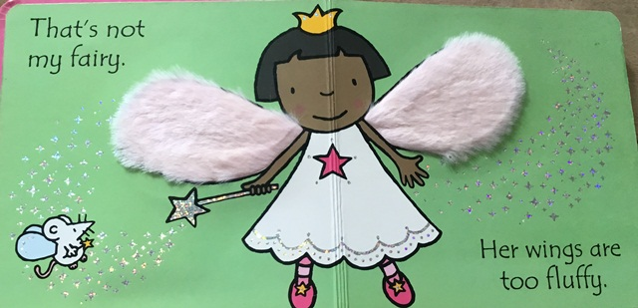
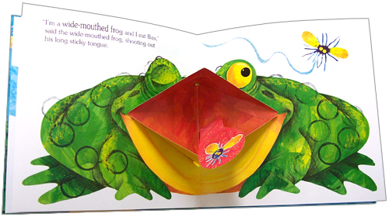
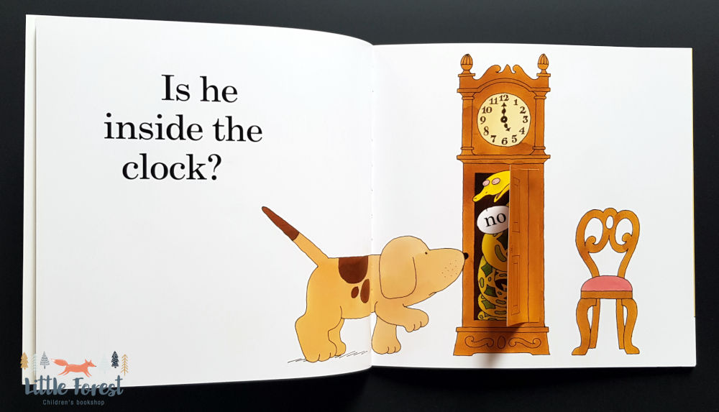
Form/format
Pop Up/Toy/Movable

Slide 34
In class Exercise 3
write an epistolary based poem or story for children
  Letter (to an animal, a cloud, a character)
  Diary entries (of a baby, of Cinderella, of a truck)
  Newspapers articles (about fairy tales, written by a child about their family)
  Something else – texts, tweets, post it notes etc

Slide 35
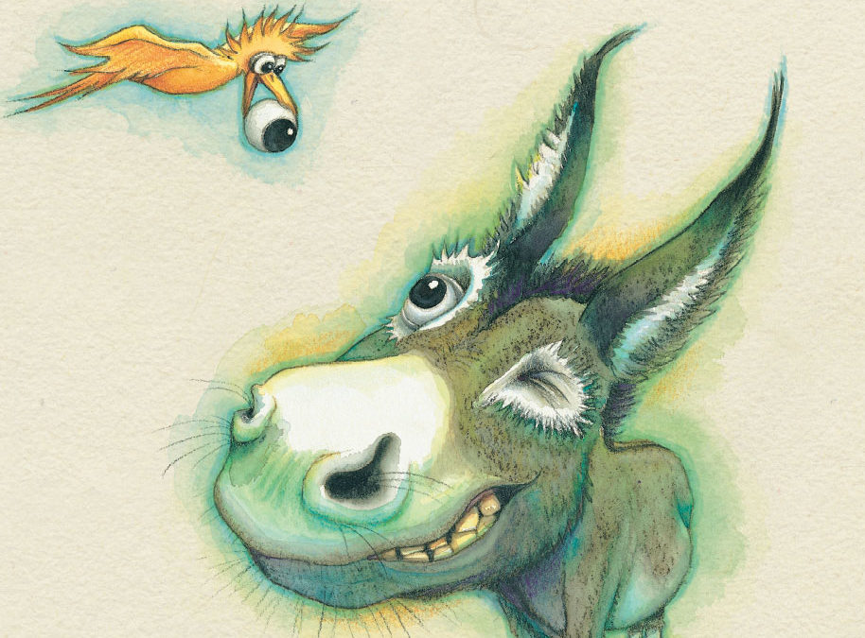
Tone/Style
Humorous
The Wonky Donkey by Craig Smith
Hop on Pop by Dr. Seuss
Usually includes humorous illustrations
Usually have an illustration style that matches the tone
Very popular with kids

Slide 36
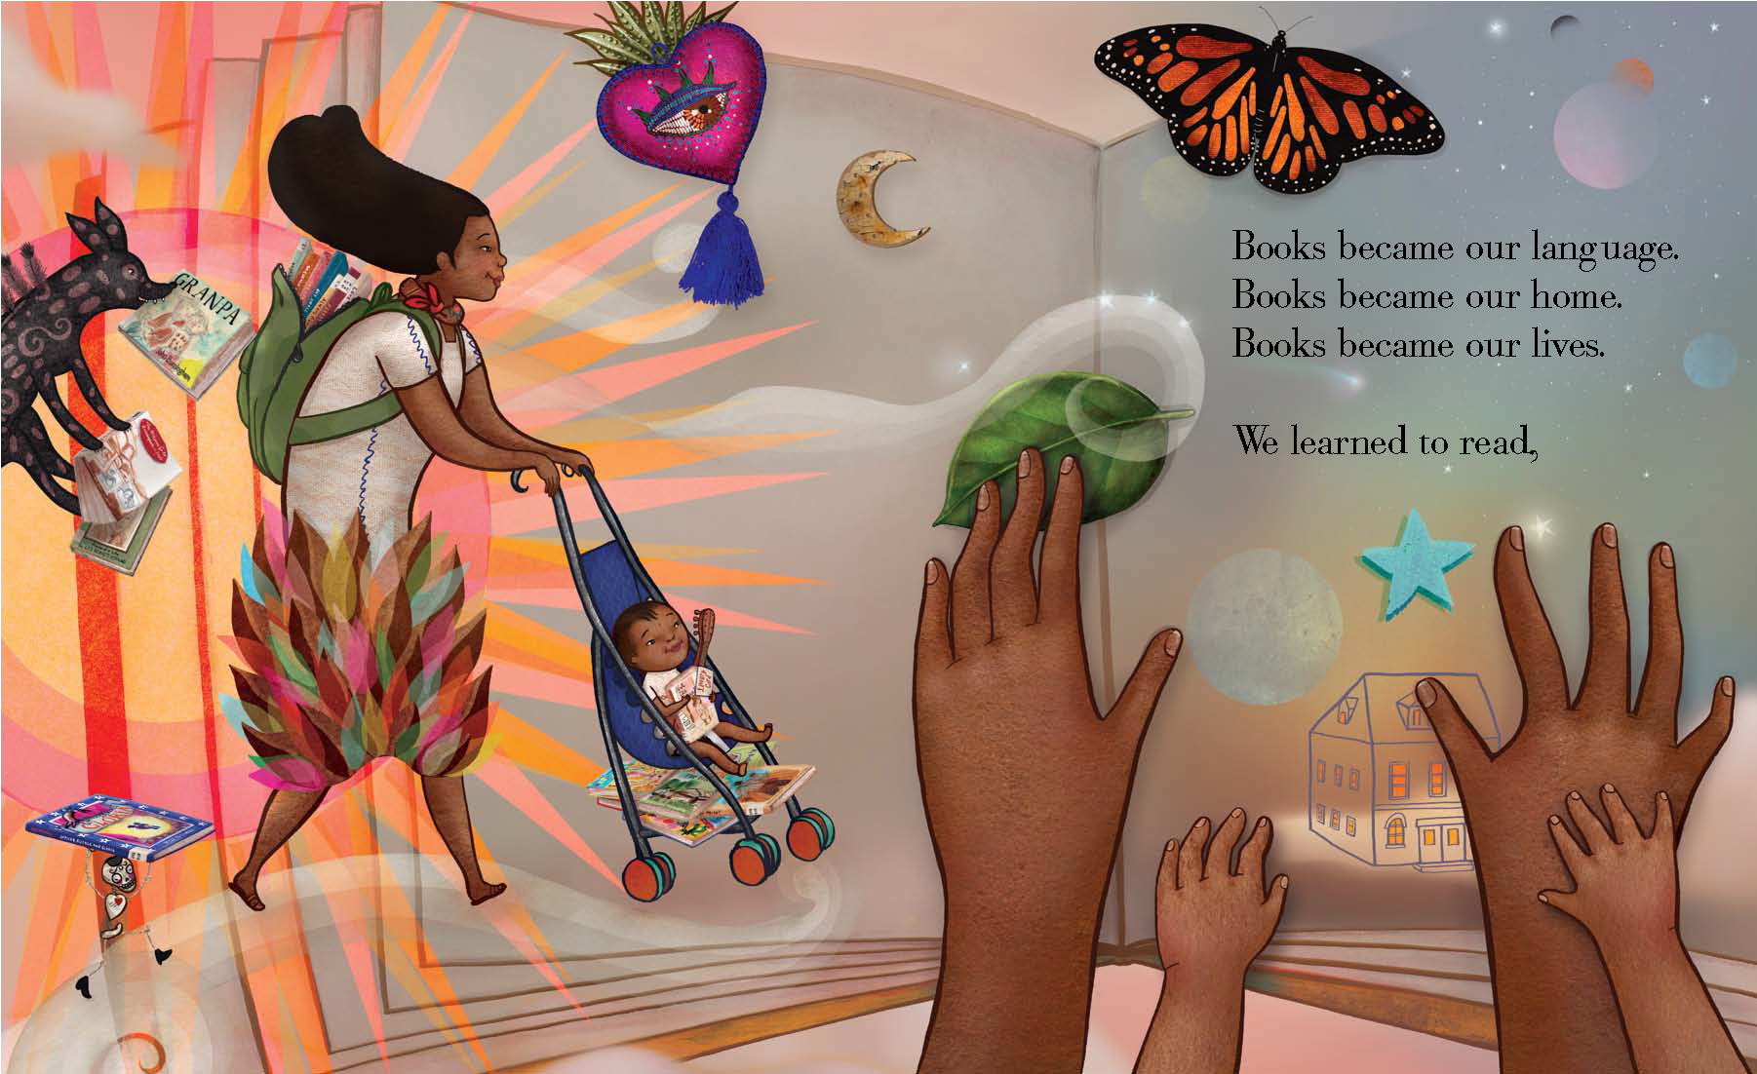
Tone/Style
Lyrical/literary
Dreamers by Yuyi Morales
Last Stop on Market Street by Matt de la Peña
Sometimes about “issues” or non-fiction
A range of illustration styles, often artistic
Often award winners
Very popular with:
  parents, librarians
  and teachers

Slide 37
Tone/Style
Non-fiction/educational
Often NOT narrative
Might include lists or diagrams etc
Usually very direct illustration style or photographs
Popular with schools and libraries
Qualify for specific awards
Need very careful research and consulting

Slide 38
Who is Your Protagonist?
Should be either a child or childlike (animal, alien etc) except in the case of a biography
If an animal are they:
a realistic animal?
  Harry the Dirty Dog by by Gene Zion
or a fantasy (talking, wearing clothes etc) animal?
  Are You My Mother by P.D Eastman
Think about the origins of the animal if possible (should a zebra be in an African setting for example?)

Slide 39
Who is Your Protagonist?
The protagonist, just as in longer fiction, should have
  an arc – room to change by the end of the book
  Strengths and weaknesses
  A milieu/setting – urban or rural, type of family etc.
  a plot – goals and obstacles.
  They might have supporting characters and/or an antagonist too

Slide 40
Who is Your Protagonist?
The protagonist, just as in longer fiction, should have
  a resolution – the story should almost always have a happy resolved ending for the protagonist and/or the reader.
Original Draft
If Pluto was a pea
The massive comet cloud we think is at the edge of the solar system would be nearly 20,000 km further out. That’s halfway around the world (12,400 miles). Imagine a pea in England and a blanket of fog covering Australia. That’s how far it might be from Pluto to the comet cloud.
The Solar System would still be very large
If Pluto was a pea.
Final Draft
If Pluto was a pea
Pluto’s smallest moon, Styx, would be too small to see.
And you would be much, much smaller than that.
But still not too small to think big thoughts
And do great things.

Slide 41
Tips
Make it new and unique
Write your first draft then delete 30%
Read and study award winning and bestselling picture books (Caldecott Award, Newbery etc)
Don’t appropriate stories you have no cultural or personal connection to.
Make large casts diverse
Don’t “preach”
Fairy tales and fables etc. are public domain as are myths and legends (stick to your own culture), Shakespeare, Dickens etc.

Slide 42
Any questions?
Website www.gsprendergast.com
Twitter @gabriellesarap
Instagram @gsprendergast
Facebook @authorgsprendergast

Slide 43
Homework
1. Collect a list of unusual or interesting sounding words. What does the SOUND of these words inspire? What about the MEANING?
Examples:
Curmudgeon — (n) a bad-tempered person
Cacophony — (n) a harsh, discordant mixture of sounds
Flummox — (v) to perplex someone greatly
Gibberish — (n) unintelligible or meaningless speech
Kerfuffle — (n) a commotion or fuss
Ragamuffin — (n) a person, typically a child, in ragged dirty clothes
Whippersnapper — (n) a young person considered to be presumptuous or overconfident
Woebegone — (adj) sad or miserable in appearance
2. Make a picture book “dummy” either by stapling pages together (ending up with 28 pages or 14 “spreads”) or in Word, Publisher or other app. Enter your own words or the words of a poem, prayer, song lyrics etc. Include sketches/notes about what the illustrations could be.
3. Develop one of the exercises or lessons of this week into a picture book manuscript of between 100-300 words

Slide 44
Elevating Your Work: How to Create Children’s Picture Books That Are Not Just Entertaining, but Transformative
Week 2!

Slide 45
Exercise: ABC and Counting Books
ABC books seem to be constantly renewed and revisited
ABC books are generally written in one of two styles:
  “A is for ________” or
  “Alison Ate Another Apple” etc.
Counting Books normally just cover numbers 1-10
Both are often “themed” – ABC Animals, Counting Shapes etc
Exercise: Conceptualize and write the first few pages of an ABC or counting book using one of above styles
Try to focus on a specific topic that is current and relevant to today’s kids

Slide 46
Share Your Homework
When offering feedback to your classmates think about:
  How might children react to this manuscript?
  How might illustrations add to this story?
  How does it sound read aloud?
  How would this manuscript be “pitched” to agents, editors and booksellers and buyers?
  What does this manuscript remind you of (ie. other picture books with similar themes or “vibe”?

Slide 47
Submitting picture books
Minimal illustration notes
Include only notes wherein the illustration needs to tell part of the story or contradict the text in an ironic way
Example from Dear Polar Bears:
Text | Illustration notes
Things here in Antarctica are okay. | Are they?
A little warmer than usual. | Maybe there’s some garbage lying around

Slide 48
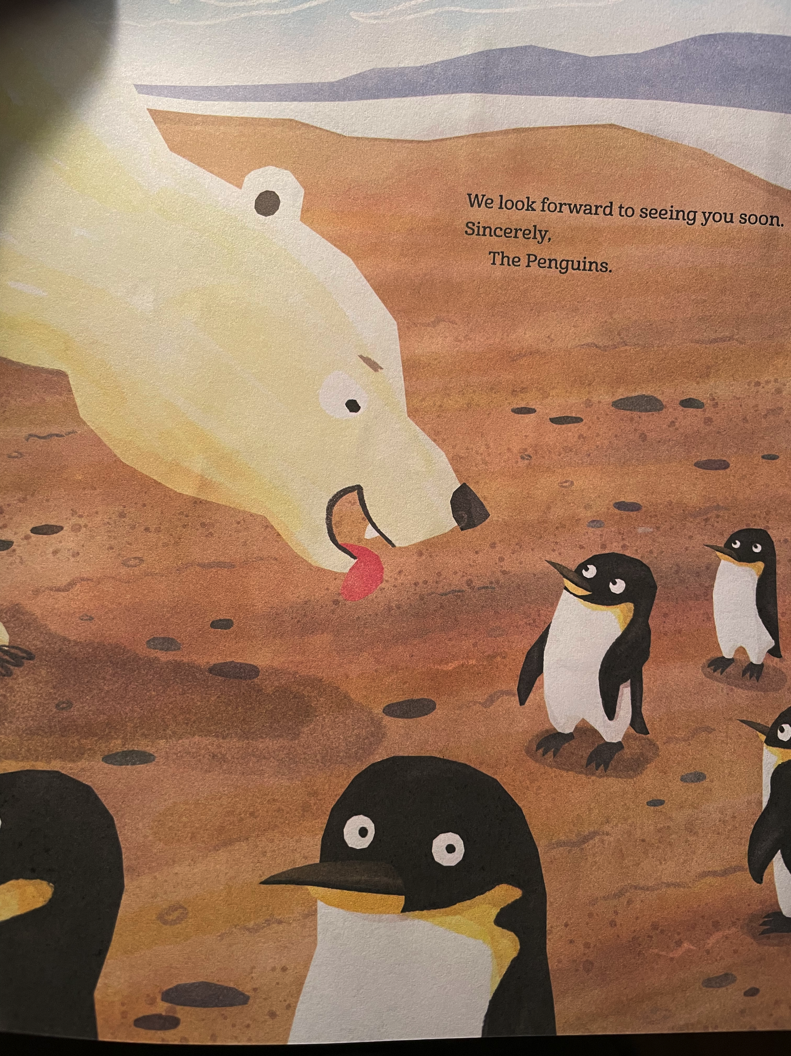
In Class Exercise
Add some illustration notes to your manuscript(s)
Rather than specific details about color, shape, placement etc give your illustrator keywords or emotional guidance. (for example: “The bears look hungry. One of the penguins looks scared”)

Slide 49
Week 2 – submitting picture books
Dear *Agent*
I’m writing to you about my picture book manuscript, Dear Polar Bears, a deceptively light-hearted story with a subtle environmental message.
Polar bears and penguins live in similar climates, but they never, ever meet. What if they had a party together? In Dear Polar Bears, the penguins of Antarctica invite the polar bears of the Arctic to join them for a party at the South Pole. But how will the Polar bears get there? And what will they bring?
Written in epistolary style, Dear Polar Bears combines a heart-warming story of friendship with some thought provoking imagery about the diversity of the arctic, the vast distances between the poles, and the impact of human life on the Polar Regions and the rest of the earth.
I’m the author of the award winning YA novels Zero Repeat Forever and Audacious, as well as the bestselling and multi-nominated middle grade novel Pandas on the Eastside. Having recently amicably parted with my agent, I am now seeking new representation for both picture books and longer form projects in middle grade, YA and adult. My first picture book, If Pluto Was a Pea, was published in 2019 from Simon & Schuster. You can read all about my books here: https://angelhornpages.wordpress.com/my-books-2/
I have attached the complete manuscript below, along with another document containing some illustration thoughts.
If you have any questions, please feel free to contact me by email at gp@angelhorn.com or by phone on 604 831 1735. I am also available on Skype or Facetime.
Sincerely
Gabrielle Prendergast
www.gsprendergast.com
Please find below my nonfiction manuscript If Pluto Was A Pea
  If Pluto was a pea, the Earth would be a golf ball.
The solar system is unimaginably large to children; and the scale of the planets and sun is very hard to grasp. But shrink Pluto down to the size of a dried pea and things become a lot easier to picture.
If Pluto Was a Pea compares the sizes of the planets to familiar things such as beach balls and acorns and helps the reader to visualize our amazing solar system.
Suitable for a photographic or simple drawing style of illustration, If Pluto Was a Pea also lends itself to classroom exercises and additional teacher guides or resources.

Slide 50
In Class Exercise
Write your short pitch (40 words)
    EXAMPLE: The solar system is unimaginably large to children; and the scale of the planets and sun is very hard to grasp. But shrink Pluto down to the size of a dried pea and things become a lot easier to picture. IF PLUTO WAS A PEA, and entertaining non fiction picture book on STEM themes
    Polar bears and penguins live in similar climates, but they never, ever meet. What if they had a party together? DEAR POLAR BEARS, a deceptively light-hearted story with a subtle environmental message.
Does your pitch answer WHO, does WHAT?

Slide 51
In Class Exercise
Write your long pitch (about 150-250 words)
    Example: The solar system is unimaginably large to children; and the scale of the planets and sun is very hard to grasp. But shrink Pluto down to the size of a dried pea and things become a lot easier to picture
    If Pluto Was a Pea compares the sizes of the planets to familiar things such as beach balls and acorns and helps the reader to visualize our amazing solar system.
    Suitable for a photographic or simple drawing style of illustration, If Pluto Was a Pea also lends itself to classroom exercises and additional teacher guides or resources.
For narrative: Does your long pitch answer WHO does WHAT, WHY, WHERE, HOW, WITH WHOM and WHO or WHAT tries to stop them?
For non-narrative: does your pitch explain the concept, the potential audience and

Slide 52
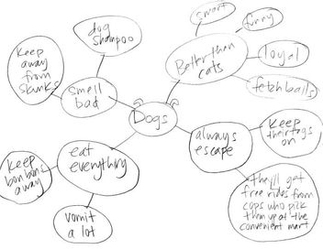
In Class Exercise:
Many authors take inspiration from existing texts or traditional stories. Example: my upcoming picture book Go Sloth Go.
Develop a picture book idea/text based on:
Baa Baa Black Sheep Humpty Dumpty Are You My Mother?
The Ugly Ducking Hey Diddle Diddle Twinkle Twinkle
Five Little Ducks Row Your Boat Green Eggs and Ha
Hop on Pop Fox in Socks A story of your choice
Start with a Mind-Map

