Slide 1
Finding the Perfect Point of View and Tense for Your Character’s Voice
with
G.S. Prendergast
Notes:
Welcome to …
I’m G.S Prendergast…
My YA novels include…My MG novels include The Frail Days and Pandas on the East Side

Slide 2
MOST IMPORTANT: DON’Ts
DON’T mix tenses. While chapters or sections can be in different tenses, scenes must have consistent and correct tense.
DON’T mix points of view. Again, chapters and sections can be different points of view but don’t mix them or be inconsistent.
DON’T mess with POV and tense just for the fun of it.
  Especially important when writing for young readers
Notes:
Start with don’ts. These are hard and fast rules that have to do with how to properly articulate your story. Consistent and correct means you’ve chosen where in time you story is and used correct grammar, or consistent and clear grammar to express that. POV – you can have more than one POV but you want to delineate them somehow. And you need to be consistent. If Your readers are children and teens, so they are not so as interested in experimental writing as adults might be. Clarity is important.

Slide 3
Tense – What you need to know
Past tense ( I walked, She heard etc) **
  Past perfect (the past of the past – I had said, she had heard)
  Past continuous can be used (I was walking, I was thinking etc)
Present tense (I walk, she hears)*
  Present continuous (I am walking)
Future tense (I will walk etc – rarely used outside dialog)
Grammatical tense will depend on your narrative tense.
Notes:
** read 1 and 2
* read 3

Slide 4
Tense – What you need to know
Grammatical tense refers to the correct (or stylized- for example in certain dialects) use of grammar. It should be consistent or logical.
Narrative tense refers to the timeline of your story. Where in time is the action taking place? From where is the story being told?
Notes:
Correct grammar – the way your teachers taught you – formal vs casual – Harry Potter – rather formal, Percy Jackson, less formal.
OR consistent grammar – if you are using a stylized tone or a regional or cultural dialect – grammar doesn’t need to be perfect but it needs to be justified and consistent. Don’t make people speak weird grammar by accident or for fun.
Narrative grammar – next slide

Slide 5
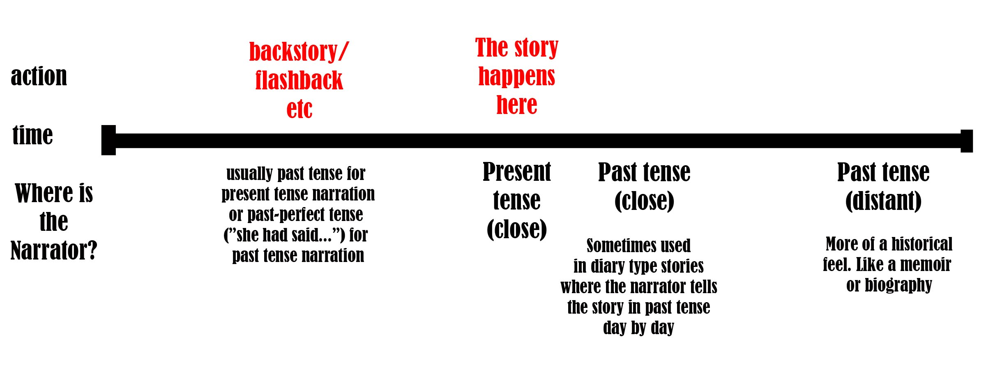
Tense – What you need to know
The most complicated (and important) thing to think about with narrative tense is the question of who is telling the story and from when are they telling it.
Past
Present
Future
The characters’
plans
Notes:
Describe the diagram
The story always happens in the present – the story is the present.
The story might have back story or flashbacks, that happened in the past
The characters might have plans for the future
JUST LIKE LIFE
But the real questions is where is your narrator? If they are experiencing the story along with the characters then present tense e

Slide 6
Tense – What you need to know
Past tense
  uses past tense verbs (she did, he went, they ran, I said etc
  Quite common in classic literature and children’s literature
  Provides a sense of “distance” from the narrative
  Can be close past or distant past*
  A bit more formal
  easier to follow
  Often combined with 3rd person but is seen with 1st person too (more on that later)
  Don’t overuse past perfect*
  Backstory told in past perfect (She had told me, I had wanted to etc) although you can be flexible with this.
Notes:
Past tense to describe the main action
Harry Potter is written in past tense
When you’re doing past perfect to describe back story, don’t overuse. Use just enough to orient the reader.
*What I was 4
*Example from Wicket Season 5

Slide 7
Tense – What you need to know
Present tense
  Uses present tense verbs (They walk, he says, I fall, she yells etc)
  Less common in classic literature
  Feels less formal
  Quite common in teen literature
  Feels very immediate, less distance from the narrative
  Very good for action scenes*
  Often combined with 1st person, quite rare with 3rd person (Unwind by Neal Shusterman is an example)
  Don’t over-use present continuous.
  Backstory told in past tense*
Notes:
Read an action scene from ZRF 6
Read backstory from ZRF 7

Slide 8
Tense Review
Don’t overuse continuous (I was walking, She is walking etc)
Think about where your narrator is in time
  Are they close to the story?*
  Are they distant from the story?
  Do they know how the story comes out?
Formal/informal
What goes best with 1st person, 3rd person, 2nd person – leads to…
Notes:
Read close past from Pandas 8

Slide 9
POV – What you need to know
Which point of view – Grammatical POV
  Grammatical point of view/tense
  1st, 2nd, 3rd person,
Whose point of view – Narrative POV
  What character(s) are the focus? Narrative point of view.
  Character’s POV can be told in any tense or grammatical POV.
    Examples – Harry Potter – 3rd person narrator, but Harry’s POV, The Book Thief, by Markus Zuzak – Narrated by Death, but mainly Liesel’s POV (she’s the protagonist)
    The Hunger Games, by Suzanne Collins, narrated by the protagonist
Notes:
Grammatical – how POV is expressed
Narrative POV – Whose story is it?

Slide 10
POV – What you need to know
1st Person Subjective – ex. The Hunger Games
1st Person Detached – What I Was by Meg Rosoff
3rd Person Limited – Harry Potter (with some exceptions)
3rd Person Objective – Rare in fiction, common in journalism
3rd Person Omniscient – Lord of the Rings
2nd Person – Stolen by Lucy Christopher
Notes:
I’ll get to the details as we move on

Slide 11
POV – What you need to know
1st Person Subjective – ex. Zero Repeat Forever, The Hunger Games
  Pronouns “I” and “me” are used by the narrator.
  The narrator is close to the action, often only knowing what the reader knows
  The narrator is usually a protagonist
  This POV gives a sense of immediacy.
  It is popular in literary and YA.
  Often in present tense (especially YA)
  Often “Deep POV”*
Notes:
Read from ZRF deep POV 9

Slide 12
POV – What you need to know
1st Person Detached ex. Who I Was by Meg Rosoff
  “I” and “me” are used
  Narrator is distanced by time or place *
  Narrator may or may not be the protagonist. Ex The Book Thief by Markus Zuzak.
  Narrator may appear to know how the story comes out *
  Past tense is often used.
  Popular in literary, autobiographical fiction, historical fiction, genre fiction
Notes:
* Read example from Who I was 10

Slide 13
POV – What you need to know
3rd Person Limited – Harry Potter (with some exceptions)
  Pronouns he, she, they etc. are used.
  Only the inner world/viewpoint of one or limited characters are known
  Often past tense
  No sense that the narrator knows the outcome
  Popular in middle grade, YA, genre
  Can be quite subjective – very close to the protagonist’s POV “Deep POV”

Slide 14
POV – What you need to know
3rd Person Objective – Rare in fiction, common in journalism
  the narrator tells what happens without stating more than can be inferred from the story's action and dialogue.
  The narrator never discloses anything about what the characters think or feel
  Little reference to past events
  Can come off as emotionless and cold

Slide 15
POV – What you need to know
3rd Person Omniscient – Lord of the Rings
  Narrator knows everything that is happening
  All points of view covered.
  Difficult to create tension because the reader knows too much
  Sometimes difficult to follow
  Popular in high fantasy
  often past tense
  BE CAREFUL OF “HEAD HOPPING” *
Notes:
* Read from Hildegarde – head hopping 11

Slide 16
POV – What you need to know
2nd Person – Stolen by Lucy Christopher
  Pronoun “you” is used.
  Can be one character speaking to another (Stolen)
  Can be a narrator speaking to a character (You by Charles Benoit)
  Slightly experimental tone*
  Can be either present or past tense
  More common in picture books, rhymes for children
  Seen in short fiction
Notes:
* (example from Welcome to Your Authentic Indian Experience by Rebecca Roanhorse)

Slide 17
Special Case – Multi POV
More than one character’s POV
  Quite common in YA (Zero Repeat Forever) and romance.
One character writing from different times
  More common in adult literary (Cat’s Eye by Margaret Atwood)
Several characters POV in several time periods (Holes)
Can be a mix of narrative POVs and/or tense (Hold Me Closer Necromancer by Lish McBride)

Slide 18
Why Write in Multi POV?
Two or more protagonists each with their connection to the main plot or their own plot
Important subplots separate from the protagonist(s)
Monogamous or polygamous romance
Antagonist has their own storyline
Two or more timelines
Loosely connected stories/experimental

Slide 19
Why Write in Multi POV?
Two or more protagonists each with their own main plot or equally involved in the main plot
  More or less equal time
  Often chapter by chapter
  Can be two POVs in one scene – broken by chapters or editorial breaks *
  Separate, possibly related conflicts
  Works well in YA romance
  Characters may be related or intersect or not
To read: Zero Repeat Forever by G.S. Prendergast, Across the Universe by Beth Revis
Notes:
* Read dual POV scene from ZRF 13

Slide 20
Why Write in Multi POV?
Important subplots separate from the protagonist(s)
  Minor or supporting characters
  Consistent throughout book, or bookend/opening chapters.
  Integrated into overall style of book
  Seen in “epic” books like Game of Thrones
  Often action taking place in several locations
To read: Unwind by Neal Shusterman
Notes:
Discuss subplots from LOTR including the Ents, Gondor and Denethor and Pippen, Aragorn and Arwen, etc

Slide 21
Why Write in Multi POV?
Two or more timelines
  Stories may or may not intersect in time
  Non-linear narrative
  May be thematically or narratively related
  may only be one narrator but in different times (ie. Child and adult)
  Often found in literary/historical fiction
To read: Holes by Louis Sachar, Cat’s Eye by Margaret Atwood.

Slide 22
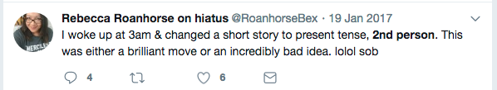
How Do You Choose Tense and POV?
Think about what you want to reader to know and when
How much do your characters know?
Do you have more than one protagonist?
Is culturally specific dialect important to your story-telling?
Who is your target reader? How sophisticated are they?
Does the POV/tense match the mood, setting etc.? (ie. Historical novels tend to use a formal past tense, 3rd person whereas YA might use 1st person present tense and informal or trendy language)
What feels natural to you? To your character?
How personal/emotional is your story?
How much backstory is there and how important is it? Would the characters know this backstory?
Emulate a the POV and/or tense or a book you admire.
Is the POV/tense you’ve chosen not working? Try a different one.

Slide 23
Most importantly:
YOUR point of view
What do you want to say?

Slide 24
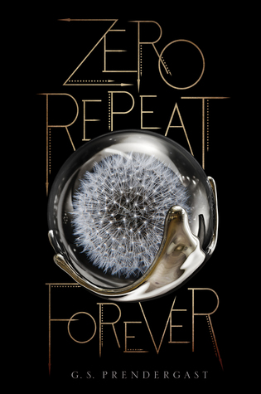
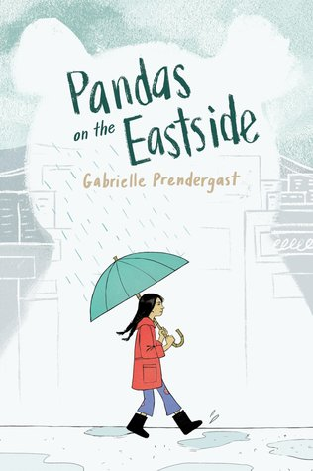
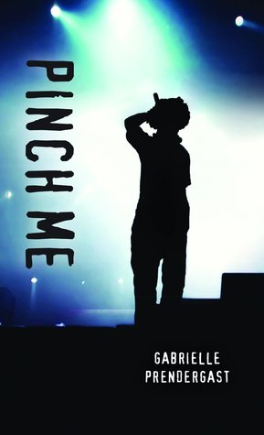
Any Questions?
www.gsprendergast.com
Twitter: @gabriellesarap
Instagram: @gsprendergast

